Slide 1
Technical Presentations in Business
TAMID Tech Track

Slide 2
Top Tech-Business Presentation Tips
When explaining code, zoom out!
Outcome-driven statements
never show code without using verbal or visual cues to explain what it’s doing
Know your audience!
Use demos
when applicable
Keep code screenshots to a minimum

Slide 3
Project Overview
Know Your Audience
Consider the range of technical knowledge in the audience
It’s always better to explain in plain english than in technical terms
Keep it simple; avoid going on long tangents when trying to get everyone on the same page
Preface Tech Terms
Using applicable “techy” language is acceptable, as long as you give background context
Applies for any frequently used definitions of tools or algorithms
Example: “For those who do not know, an API can be used to extract data from different websites and services”
Structure Your Explanation
Step 1: Discuss the project’s mission statement
Step 2: Explain what tools/ technologies you used to achieve these goals
Example: “Our goal was to create a tool that measures nutrition of online recipes, so we used the Tasty API to grab recipe information from Tasty.com, followed by another tool, the Edamam API, to rate its nutrition. This lead us to have an output of nutrition information from the input of an online recipe. ”

Slide 4

Zoom Out
Don’t explain how it works. Explain what it does and why!
Focus on IMPACT, not PROCESS
Delving into the inner workings of a technology can be an interest-killer, especially in a pitch setting
Focus instead on the applications of your product, its target market, and why it will succeed
When fielding questions from the audience, you can use that time to mention you are happy to explain the further technical details on request

Slide 5

Utilizing Demos in Your Presentation
Do a demo if...
You can provide visualizations or calculations that could aid comprehension of purpose
Time allows it; If you run through a demo too quickly, or stretch out the demo to fill time, the audience will lose interest.
Time yourself when practicing to better understand your pacing
You can demonstrate expertise in the product space
Prepare to be pressed on specific of your product and its market. Example: “What differentiates your product from similar product X”

Slide 6
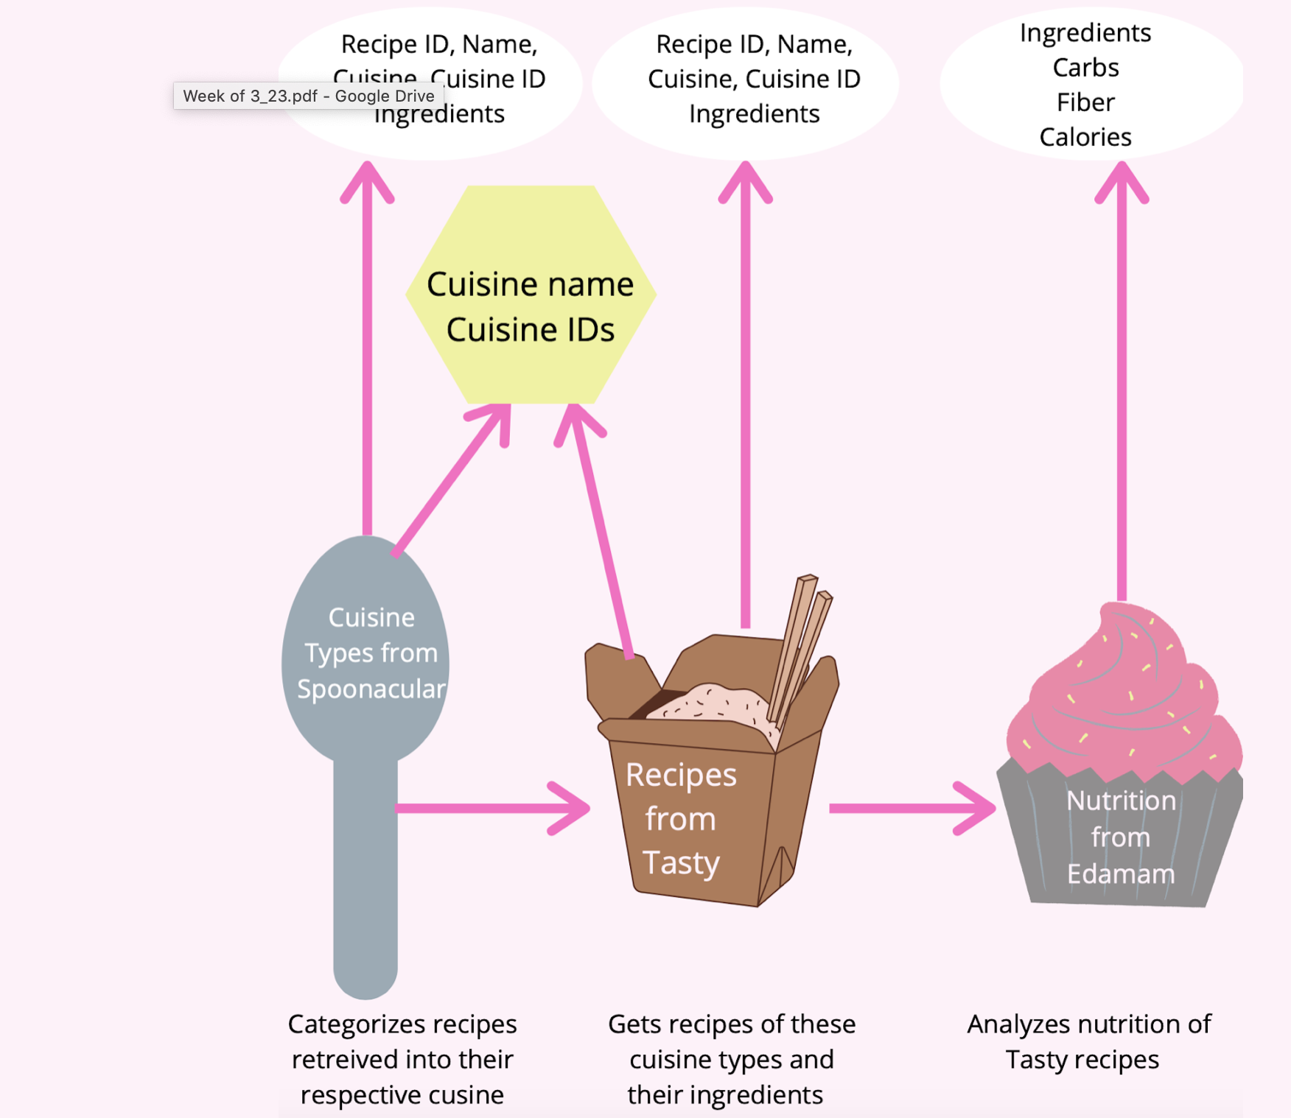
Diagramming
Can be a good visual aid to show process
Use creative visual representations
Remember not to get too technical here
Example

